Slide 1


Airbnb as a Potential Competitor and its impact on the Hotel Industry
DATS 6103 - Individual Project 2 – Vishnupriya Venkateswaran

Slide 2
Overview
Introduction
Background of Dataset
Exploratory Data Analysis
Airbnb vs hotels
Future Research
Conclusion
Tools and Packages
Reference

Slide 3
Introduction
Airbnb is a company whose website permits local people to rent out their residences as tourist accommodations.
Users on Airbnb can book a place to stay in more than 34,000 cities across 190 countries.
Airbnb have addressed the much more challenging problem of the sharing of goods, where unlike selling a good, retaining the post-transaction value of the good is essential for the owner.
Impact of Airbnb on hotel industry.
Plan of study using data mining techniques with various python libraries and tools.

Slide 4
Background of datasets
1.Airbnb Listings Data - The Airbnb listings data is collected from Insiderairbnb.com. It has Airbnb listings for 46 countries across the globe for the years 2008 to 2017
2.Hotels Data – The hotels data is collected via web scrapping from opendata.dc.gov , Trip Advisor and Hotels.com

Slide 5
States Considered
For the purpose of the project the states considered are:
Boston, Massachusetts
Washington, D.C
New York City

Slide 6
Exploratory data analysis
Analyzing Trends in Airbnb listings In Boston
There are 4863 Airbnb listings in boston
Allston–Brighton, Back Bay, Dorchester, Jamaica plain and Fenway–Kenmore has the most number of airbnb listings making it the top 5 popular neighborhoods in Boston.
Most popular type of property rented as Airbnb are apartments.

Slide 7
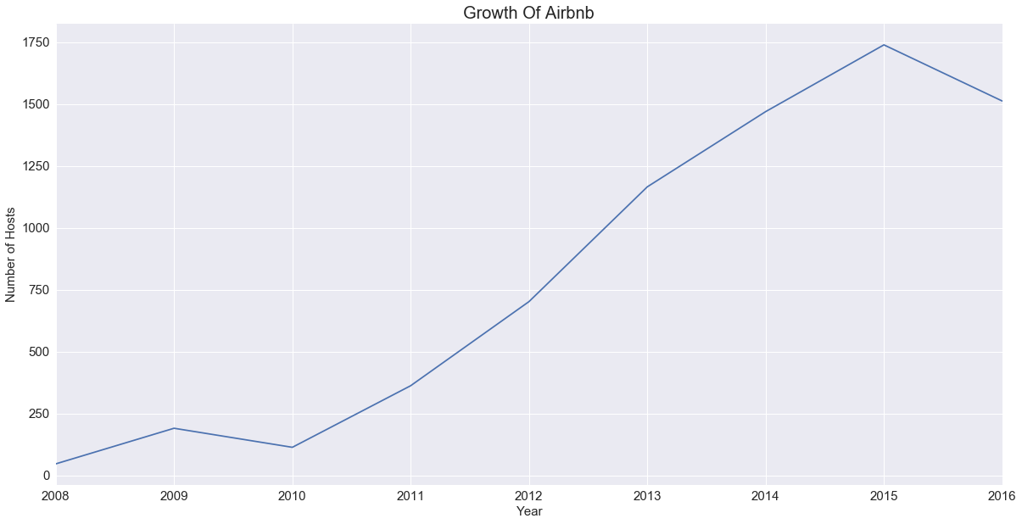
Trends in Airbnb listings In Washington,D.c
There are 7649 Airbnb listings in Washington,D.C
Growth of Airbnb from 2008 to 2016 is as presented in the graph

Slide 8
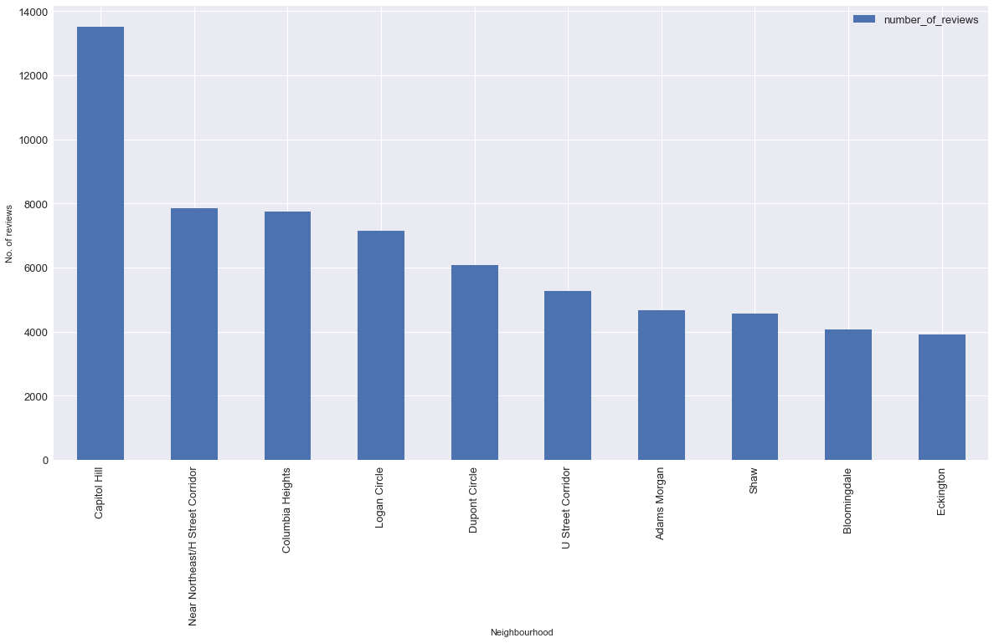
Top 10 neiborhoods in DC based on the number of customer reviews

Slide 9
Trends in Airbnb New York
Entire-home/apartment listings account for 75% ($490 million) of total Airbnb revenue and represent 51% of total listings.
Nearly 300 unique listings earned $100,000 or more last year.
Airbnb growth in New York City has slowed down considerably. Revenue-earning listings grew by only 4.5% (to 67,100) citywide, and even shrunk by 3% (to 34,000) in Manhattan. Total host revenue grew by 14% (to $657 million) between 2016 and 2017, a major slowdown from the previous year’s growth rate of 35% (to $576 million).
The New York law is particularly worrisome for Airbnb. Airbnb was sued by new York government in 2016. hence there was a drop in Airbnb listings in 2016.
The law suit was settled in January 2017.

Slide 10
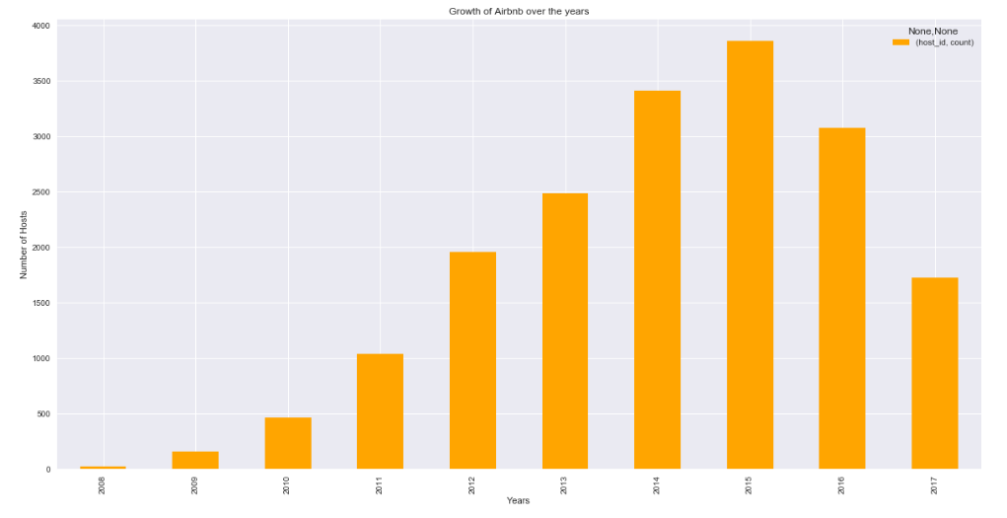
Growth of Airbnb over the years based on the number of hosts in new York city.

Slide 11

Impact of Airbnb on the hotel industry

Slide 12
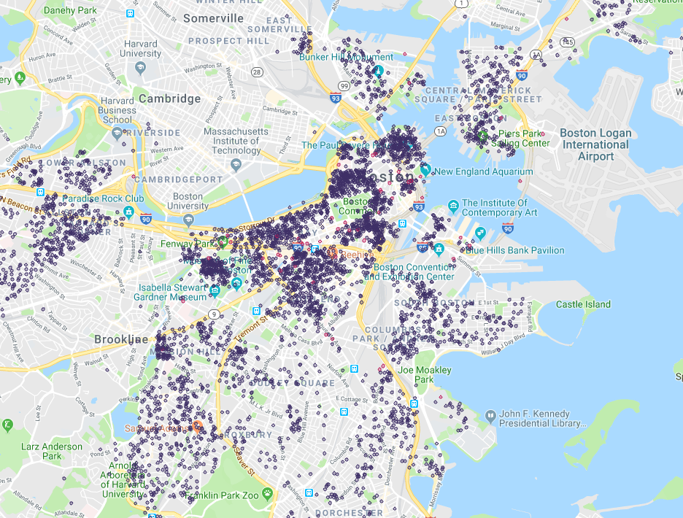
There are over 60 hotels in Boston in comparison to the large number of Airbnb Listings
gmplot to generate a html file with different airbnb listings and hotels in Boston.
Red dots indicate the hotels and the blue indicates the Airbnb listings in the area.

Slide 13
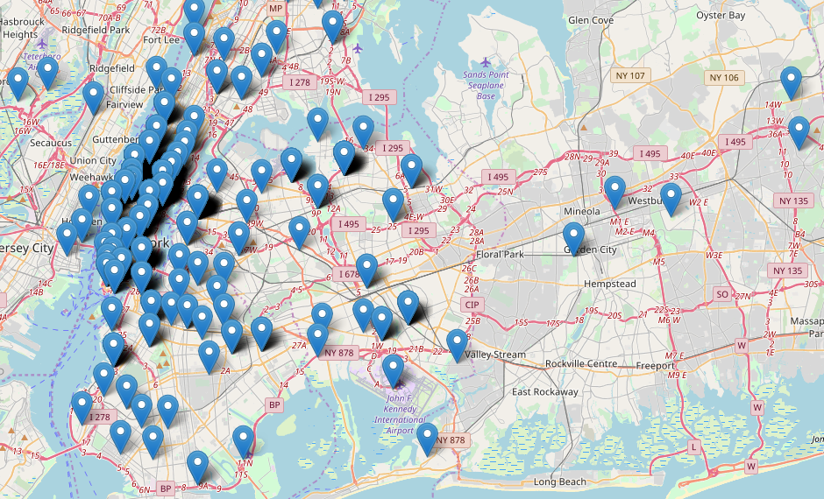
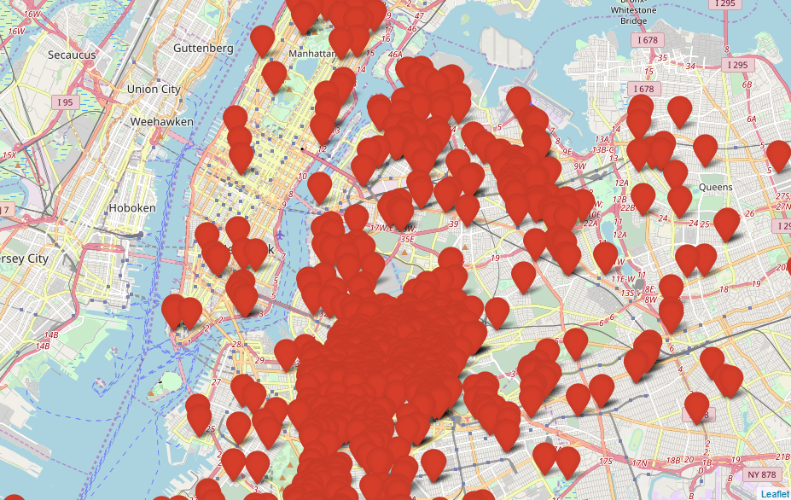
Number of Hotels Vs Number of Airbnb listings in new York city

Slide 14
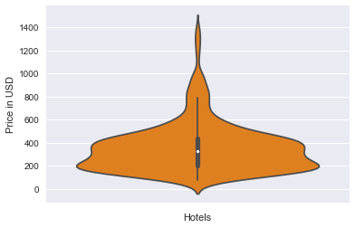
Pricing Difference between Airbnb and Hotels
Pricing for Hotels
Statistical Description can be seen in the violin plot
Maximum price: $1395 USD
Average price: $355 USD
Lowest Price: $72 USD
The highest price for a normal room in a hotel is about $1400 USD

Slide 15
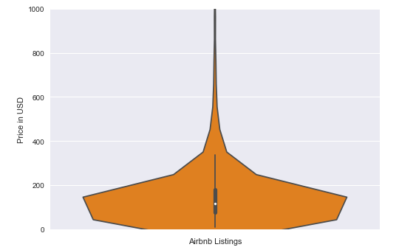
Pricing of an Airbnb listing
Maximum Price: $10000 USD
Average Price: $156 USD
Minimum Price: $10 USD
The cost of most of the Airbnb listings are relatively lesser than a hotel.

Slide 16
Future Research
Get pricing revenue data for hotels and Airbnb listings are compare them
Consider Airbnb and hotel pricing in each county
Study on preference of Airbnb over hotel by studying the different amenities.
The Hotel Industry’s 2017 Plans to Combat Airbnb
Study Airbnb’s across other countries

Slide 17
Conclusion
in less than a decade, Airbnb has transformed how millions of people travel, building a global marketplace around short-term apartment and room rentals.
From 2010 Airbnb has grown immensely.
Airbnb has accommodated more than 50 million Guests in 2015. This puts the company on track to pass 100 million in 2016.
The number of Airbnb listings are so high compared to hotels in major tourist cities like Boston, Washington, dc and new York.
The pricing is considerably low for Airbnb listings than in hotels and plus you get to live like a local to get a whole new experience from your trip.
It is definitely a threat to the hotel industry.
Airbnb will obviously continue to grown looking at all the stats and advantages it has to offer.

Slide 18
Tools and packages
Python
Libraries
pandas
Matplotlib.pyplot
Numpy
Display
Math
Date-time
Us zipcode
Charts
Histograms
Line graphs
Seaborn
Gmplot
folium

Slide 19
refernces
insideairbnb.com/get-the-data.html
www.tripadvisor.com/
opendata.dc.gov/

Slide 20

Thank you

